Slide 1
Repetition Session 7
Course : COMP6056
Effective Period : September 2021

Slide 2
Sub Topics
Introduction to Repetition Structure
Condition controlled loop
Count control loop
Calculating a running total
Sentinels
Nested Loop

Slide 3
These slides have been adapted from: Gaddis, T. (2019). Starting Out with Programming Logic and Design 5^{th.} ISBN: 978-0-13-480115-5 Chapter 5
Acknowledgement

Slide 4
Learning Objectives
At the end of this lecture, students are able to:
LO1: To explain the uses of repetition structure
LO2: To write pseudo-code to solve problem containing repetitions

Slide 5
Introduction to Repetition Structure
A repetition structure causes a statement or set of statements to execute repeatedly
Allow a programmer to avoid duplicate code.
Duplicate code makes a program large.
Write a long sequence of statements is time consuming.
If part of the duplicate code has to be corrected or changed, then the change has to be done many times.
Gaddis, T., Starting Out With Programming Logic and Design, 5 ed, ISBN: 978-0-13-480115-5

Slide 6
Introduction to Repetition Structure
Instead of writing the same sequence of statements over and over, a better way to repeatedly perform an operation is to write the code for the operation once, and then place that code in a structure that makes the computer repeat it as many times as necessary.
This can be done with a repetition structure, which is more commonly known as a loop.
Gaddis, T., Starting Out With Programming Logic and Design, 5 ed, ISBN: 978-0-13-480115-5

Slide 7
Condition-Controlled Loops
While Loop
While a condition is true, do some task
Do-While Loop
Do some task, while condition is true
Do-Until Loop
Do some task, while a condition is false (or until it’s true)
With all loops, be careful not to create infinite loops – always provide a way to break out
Gaddis, T., Starting Out With Programming Logic and Design, 5 ed, ISBN: 978-0-13-480115-5

Slide 8
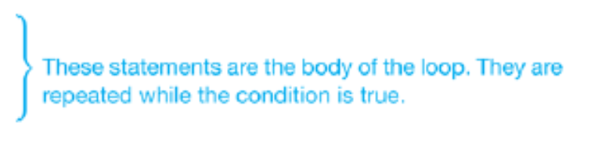
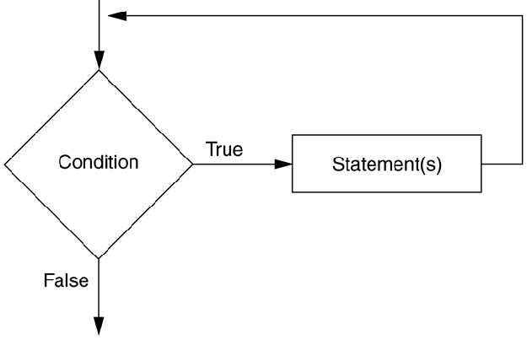
Condition-Controlled Loops
The While Loop – pretest loop
While condition
Statement
Statement
End While
Gaddis, T., Starting Out With Programming Logic and Design, 5 ed, ISBN: 978-0-13-480115-5

Slide 9
Condition-Controlled Loops
Writing Convention
Make sure the While clause and the End While clause are aligned.
Indent the statements in the body of the loop.
By indenting the statements in the body of the loop you visually set them apart from the surrounding code.
This makes your program easier to read and debug. Also, this is similar to the style that most programmers follow when writing loops in actual code.
Gaddis, T., Starting Out With Programming Logic and Design, 5 ed, ISBN: 978-0-13-480115-5

Slide 10
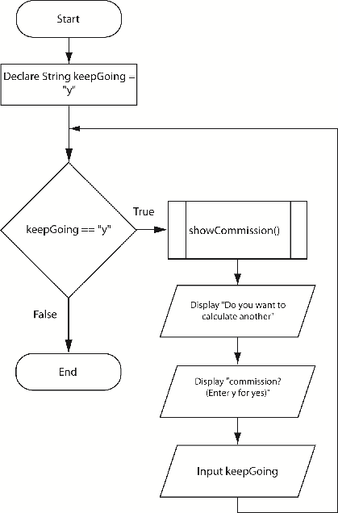
Condition-Controlled Loops
Working with Modules and Loops
To run a program multiple times, modules can be put within a loop
Gaddis, T., Starting Out With Programming Logic and Design, 5 ed, ISBN: 978-0-13-480115-5

Slide 11
Condition-Controlled Loops
The Do-While Loop – posttest loop
Do
Statement
Statement
While condition
Gaddis, T., Starting Out With Programming Logic and Design, 5 ed, ISBN: 978-0-13-480115-5

Slide 12
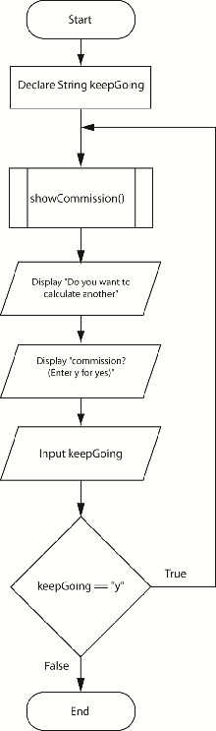
Condition-Controlled Loops
Gaddis, T., Starting Out With Programming Logic and Design, 5 ed, ISBN: 978-0-13-480115-5

Slide 13
Condition-Controlled Loops
Writing Convention
Make sure the Do clause and the While clause are aligned.
Indent the statements in the body of the loop.
Gaddis, T., Starting Out With Programming Logic and Design, 5 ed, ISBN: 978-0-13-480115-5

Slide 14
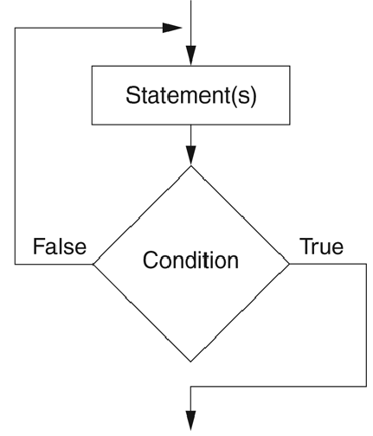
Condition-Controlled Loops
The Do-Until Loop
Loop iterates until a condition is true, but not all languages support this type of loop
Because the Do-Until loop is a posttest loop, it will always iterate at least one time.
Gaddis, T., Starting Out With Programming Logic and Design, 5 ed, ISBN: 978-0-13-480115-5

Slide 15
Count-Controlled Loops
A count-controlled loop iterates a specific number of times
A for loop is best used for this situation
For counterVariable = startingValue to maxValue
statement
statement
End for
There is an Initialization, Test, and Increment expression that controls the loop
Gaddis, T., Starting Out With Programming Logic and Design, 5 ed, ISBN: 978-0-13-480115-5

Slide 16
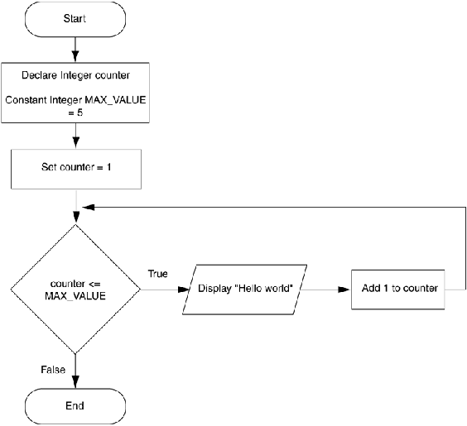
Count-Controlled Loops
For loops can also increment by more than one, count backwards by decrementing, or allow the user to control the number of interactions
Gaddis, T., Starting Out With Programming Logic and Design, 5 ed, ISBN: 978-0-13-480115-5

Slide 17
Count-Controlled Loops
General loop concerns
Do not forget to initialize the loop control variable
Do not forget to modify the loop control variable
Many loops are interchangeable, but generally
Use while loop when loop may not have to process
Use do while when it must process at least once
Use for loop with specific number of iterations
Gaddis, T., Starting Out With Programming Logic and Design, 5 ed, ISBN: 978-0-13-480115-5

Slide 18
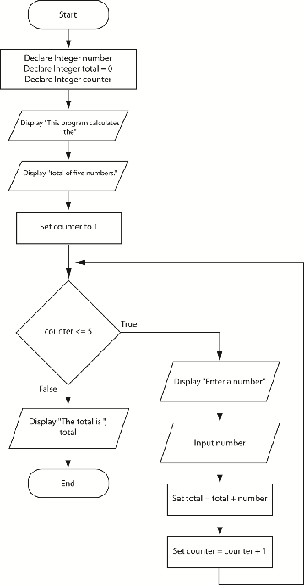
Calculating a Running Total
A running total is a sum of number that accumulates with each iteration of a loop
Gaddis, T., Starting Out With Programming Logic and Design, 5 ed, ISBN: 978-0-13-480115-5

Slide 19
Sentinels
A sentinel is a special value that marks the end of a list of values, used as stop values for loops
How it can be done
Ask the user at the end of each loop iteration, if there is another value to process
Ask the user at the beginning of the loop, how many times the loop should process
Gaddis, T., Starting Out With Programming Logic and Design, 5 ed, ISBN: 978-0-13-480115-5

Slide 20
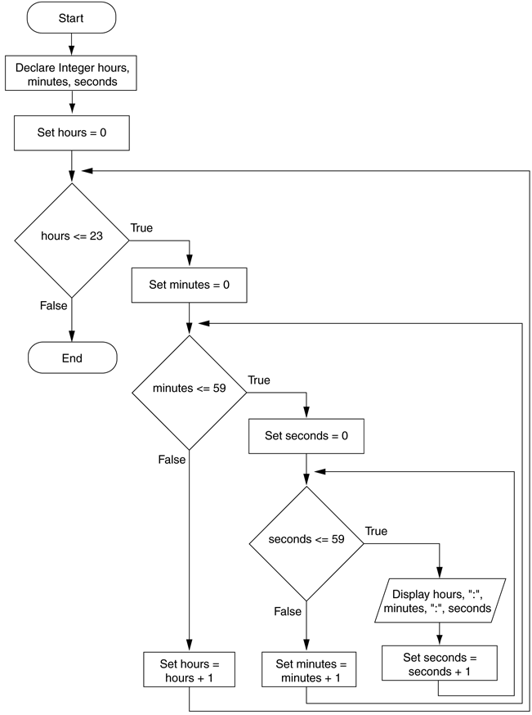
Nested Loops
All loops can be nested, that is, a loop inside of a loop
Gaddis, T., Starting Out With Programming Logic and Design, 5 ed, ISBN: 978-0-13-480115-5

Slide 21
References
Gaddis, T. (2019). Starting Out with Programming Logic and Design 5th. ISBN: 978-0-13-480115-5

